Slide 1
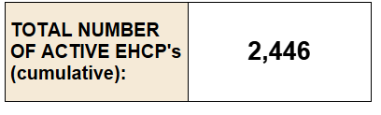
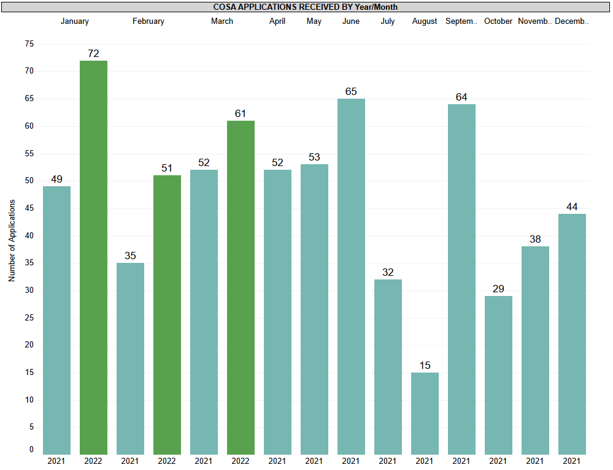

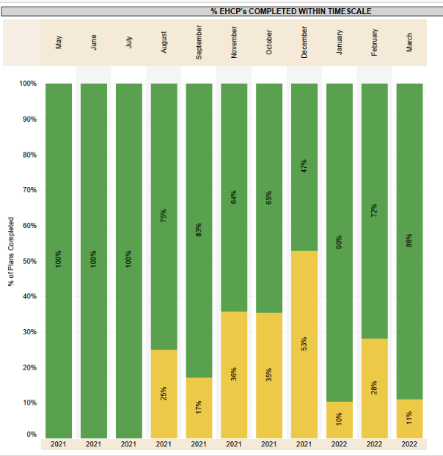

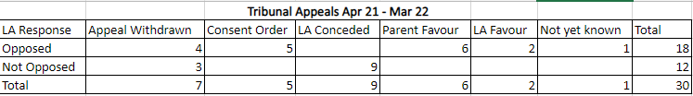






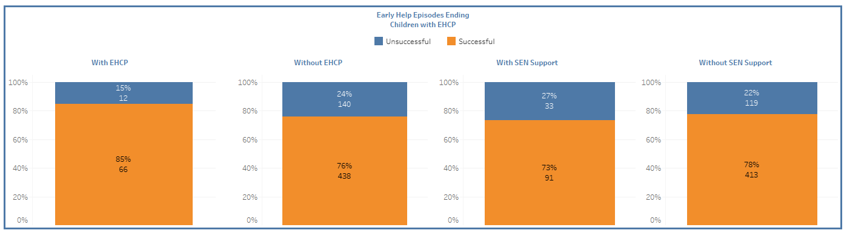
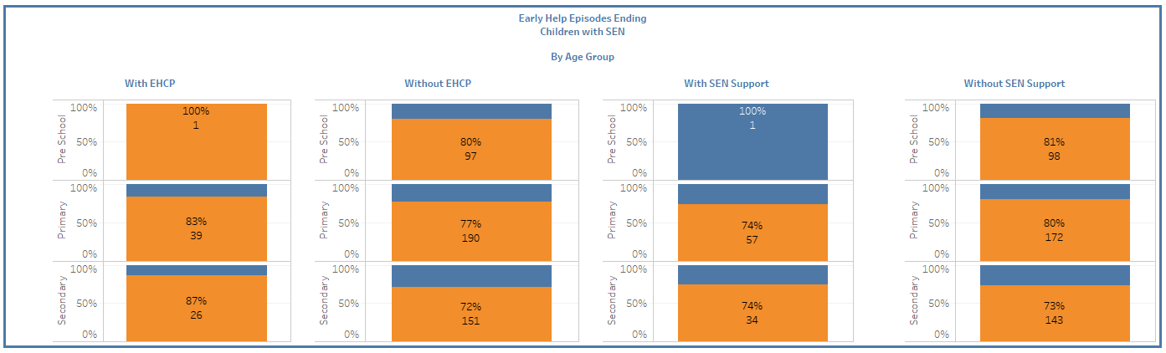

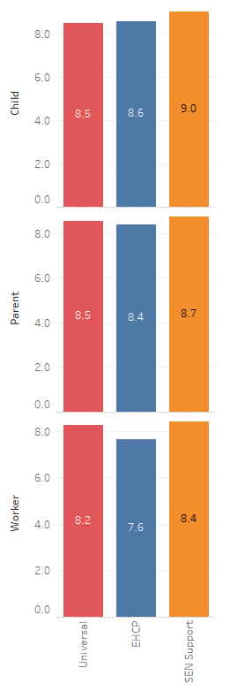
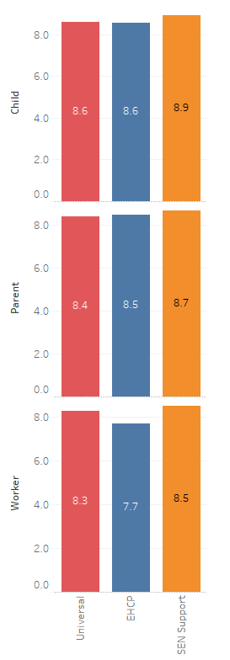
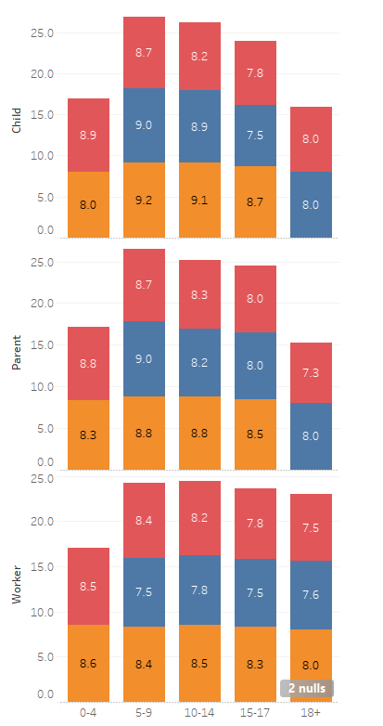
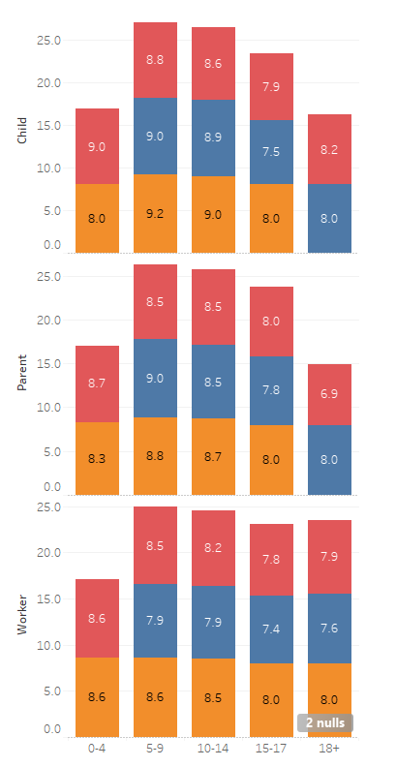
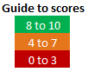
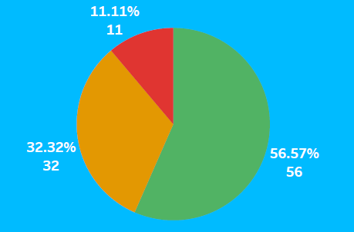
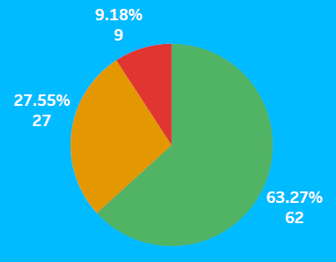
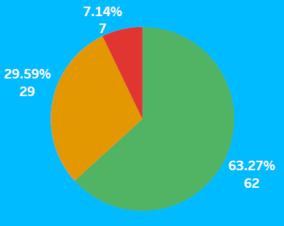
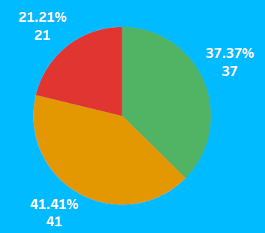
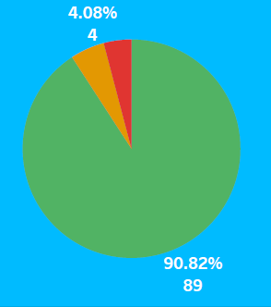
Northumberland’s SEND Outcomes
UPDATED: MAY 2023
(Next update for 2022/23 will be in autumn 2023)
N.B - Red, Amber or Green text denotes that the latest figure is poorer, broadly similar, or better than the base lines (which are on the left hand side where available.) Where stated, Red and Green can also denote if the latest figure is poorer or better than the national average.
Education, Health and Care Plans
(Updated to March 2022)
2,721
Total Number of learners receiving SEN Support | 6,168
PREV - 2,446
(Apr 21)
(schools reviewing their data in October 2022)
(includes yr 12’s and yr 13’s)
PREV – 5,198
(Apr 21)
Base line (2017/18 unless stated otherwise)
Most Recent
Education and Pathways to Employment
of SEN Support pupils were persistent absentees
(10+)
26.0%
of EHCP pupils were persistent absentees (10+)
18.4%
of SEN Support pupils were persistent absentees
(10+)
38.8%
of EHCP pupils were persistent absentees (10+)
31.9%
overall absence of SEN Support pupils
6.60%
overall absence of EHCP pupils
9.30%
overall absence of SEN Support pupils
12.8%
overall absence of EHCP pupils
9.80%
167
Fixed term exclusions involving EHCP pupils (Sep 18- Aug19)
831
Fixed term exclusions involving SEN Support pupils (Sep 18-Aug 19)
266
Fixed term exclusions involving EHCP pupils (Sep 21-Aug 22)
1196
Fixed term exclusions involving SEN Support pupils (Sep 21-Aug 22)
4
EHCP pupils with permanent exclusions (Sep 18-Aug 19)
23
SEN Support pupils with permanent exclusions (Sep 18-Aug19)
1
EHCP pupils with permanent exclusions (Sep 21-Aug 22)
23
SEN Support pupils with permanent exclusions (Sep 21-Aug 22)
8.0%
Y12 & Y13 EHCP young people who are NEET or whose destination is unknown (March 2019)
9.4%
Y12 & Y13 EHCP young people who are NEET or whose destination is unknown (June 2019)
16.4%
Y12 & Y13 EHCP young people who are NEET or whose destination is unknown (March 2022)
14.1%
Y12 & Y13 EHCP young people who are NEET or whose destination is unknown (June 2022)
(SEN Support pupils) good level of development
*To be updated when the complete 2021/22 school year data set is available
6.52%
(EHCP pupils)
good level of development
35.3%
of SEN Support pupils WA expected standard in phonics
5.1%
*(EHCP pupils)
good level of development
24.1%
*(SEN Support pupils) good level of development
19.0%
of EHCP pupils WA expected standard in phonics
51.5%
15.2%
*of EHCP pupils WA expected standard in phonics
48.1%
*of SEN Support pupils WA expected standard in phonics
0%
EHCP pupils achieved expected standard (KS1)
26.2%
SEN Support pupils achieved expected standard (KS1)
5.5%
*EHCP pupils achieved expected standard (KS1)
20.6%
*SEN Support pupils achieved expected standard (KS1)
1.10%
EHCP pupils achieved expected standard (KS2)
27.1%
SEN Support pupils achieved expected standard (KS2)
7.2%
*EHCP pupils achieved expected standard (KS2)
20.4%
*SEN Support pupils achieved expected standard (KS2)
11.4%
average attainment 8 score of EHCP
27.8%
average attainment 8 score of SEN Support
12.1%
*average attainment 8 score of EHCP
31.5%
*average attainment 8 score of SEN Support
*To be updated when the complete 2021/22 school year data set is available
6.50%
of EHCP pupils achieving L5+ in E&M (basics)
10.8%
of SEN Support pupils achieving L5+ in E&M (basics)
4.8%
*of EHCP pupils achieving L5+ in E&M (basics)
18.0%
*of SEN Support pupils achieving L5+ in E&M (basics)
2.80%
of EHCP pupils entered for EBACC
7.20%
Of SEN Support pupils entered for EBACC
1.2%
*of EHCP pupils entered for EBACC
10.3%
*of SEN Support pupils entered for EBACC
19.4%
of EHCP 19 year olds qualified to L2 (inc E&M)
31.7%
Of SEN Support 19 year olds qualified to L2 (inc E&M)
17.9%
of EHCP 19 year olds qualified to L2 (inc E&M)
(2021)
28.5%
of SEN Support 19 year olds qualified to L2 (inc E&M) (2021)
15.1%
of EHCP 19 year olds qualified to L3
22.7%
of SEN Support 19 year olds qualified to L3
12.8%
of EHCP 19 year olds qualified to L3
(2021)
22.4%
Of SEN Support 19 year olds qualified to L3 (2021)
31.1%
of C&YP
with EHCPs in mainstream schools
32.3%
of C&YP
with EHCPs in mainstream schools (March 2022)
Most Recent (2021/22)
Base line (2018-2020)
Health
wait time for C&YP referred to MH teams (within 18 weeks)
100%
NHS supporting C&YP with SEND who are good & outstanding
100%
wait time for C&YP referred to MH teams (within 18 weeks)
100%
NHS supporting C&YP with SEND who are good & outstanding
100%
70.0%
accessing CYPS MH within 12 weeks of referral
63%
Average ASD/ ADHD waiting times (within 18 weeks)
100%
accessing CYPS MH within 12 weeks of referral
100%
Average ASD/ ADHD waiting times (within 18 weeks)
8.6 weeks
Average waiting time for C&YP referred to MH Teams
32.0%
of C&YP with LD who receive an annual health check
3.1 weeks
Average waiting time for C&YP referred to MH Teams
91.9%
of C&YP with LD who receive an annual health check
90.6%
Receiving the 2-2.5yr Healthy Child Programme (HCP) review
Waiting times for SLT & OT
(Percentage seen within 18 weeks)
91.4%
Receiving the 2-2.5yr Healthy Child Programme (HCP) review
Waiting times for SLT & OT
(Percentage seen within 18 weeks)
91.0%
Of those, developing well on the 5 measures
92.0%
Occupational Therapy (OT)
89.4%
Of those, developing well on the 5 measures compared to the national average
81.0%
Occupational Therapy (OT)
99.0%
Speech & Language Therapy (SLT)
99.0%
Speech & Language Therapy (SLT)
Early Help & Social Work
DATA: APRIL 2022 TO SEPTEMBER 2022
Early Help Episodes Ending
When comparing the data for Early Help involvements that were completed successfully, or otherwise, the results are better for children with an EHCP than those who don’t (85% successful with, 76% without). The data for those with identified SEN Support needs are slightly lower (73% successful with, 78% without). This data indicates that those with SEND are not being left behind their peers as the figure for all children and families was 75% for the 2021/22 year.
The chart below shows the breakdown of children with and without an EHCP and SEN Support by age group. When comparing the difference in successful outcomes by age groups, the outcomes are better for those with EHCPs across all age groups. For those with SEN Support the primary age group is lower and it is slightly higher for secondary pupils. Notably the pre-school group is considerably different but due to the low numbers it is not comparable.
The information below has been captured by looking at social work closed cases that ended. The data is produced on the scores received from the case worker, adult and child, and is scored between 1-10, based on the effectiveness of the service, 10 being best.
AVERAGE SCORE BASED ON THE EFFECTIVENESS OF THE SERVICE ACROSS THE YEAR FOR SEN SUPPORT AND EHCP CLIENTS
If we look at all those cases closed across April to September 2022, we can see that the scores received for the effectiveness of the service are higher for those children and young people identified with SEN Support need, than for those without SEN and those with an EHCP. Again, these scores indicate that children and young people with SEN are not being left behind those without SEN.
2021-2022
Apr 22 – Sep 22
2021-2022
Apr 22 – Sep 22
Breaking down the perceptions of service effectiveness by age, and comparing April 22 to September 22 with the figures from 2021/2022 we can see that there has been reduction in SEN Support across the child, parent and workers scores with the 15-17 age bracket while others have remained stable.
Looking at children who had EHCP plans, over the last 6 months we can see that there has been an increase in the workers score across the 5-9 and 10-14 age bracket but a slight reduction in those in the 15-17 age group.
Base line (2018/19)
Most Recent (Q1 2023)
Community Inclusion and Independent Living (18-25 yr olds)
83.0%
percentage clients with a completed adult social care assessment before their 18th birthday (2020/2021)
92.3%
percentage clients with a completed adult social care assessment before their 18th birthday
Clients with a Learning Disability aged 18-25:
Clients with a Learning Disability aged 18-25:
4.0%
were in paid employment
95.3%
were living in their home or with family
8.5%
are in paid employment (LD)
94.3%
are living in their home or with family (LD)
6.4%
LD clients aged 18-25 who volunteered
4.7%
LD clients aged 18-25 who volunteer
Clients with a Physical Disability aged 18-25 :
Clients with a Physical Disability aged 18-25 :
97%
Live in their own home or with their family
5.4%
in paid employment
5.4%
who volunteer
100%
Live in their own home or with their family
21.1%
in paid employment
0.0%
who volunteer
Clients with a Mental Health difficulty aged 18-25 :
Clients with a Mental Health difficulty aged 18-25 :
98.4
Live in their own home or with their family
17.1%
in paid employment
0.0%
who volunteer
100%
Live in their own home or with their family
15.4%
in paid employment
1.9%
who volunteer
Listening to Children, Young People & Parents
The main reasons for SENDIASS referral were...
Through our direct work with children and young people receiving support from NIES, they have told us:
8.0%
Data from 01/07/21 – 31/03/22
I learn well at school
PREV (APR – MAY 21)
RED (9.00% - 19)
AMBER (33.18% – 70)
GREEN (57.82% - 122)
How to request an EHC needs assessment
21.0%
People at school help me to learn
PREV (APR – MAY 21)
RED (6.22% - 13)
AMBER (25.36% – 53)
GREEN (68.42% - 143)
Staff at school listen to what I say about my learning and how to help me
PREV (APR – MAY 21)
RED (4.76% - 10)
AMBER (27.62% – 58)
GREEN (67.62% - 142)
Concerns about SEN support provision in school/college
27.0%
Advice about educational placement
I can manage the ups and downs of life
PREV (APR – MAY 21)
RED (15.79% -33)
AMBER (47.37% – 47)
GREEN (36.84% - 77)
I do things outside school that I enjoy
PREV (APR – MAY 21)
RED (2.86% – 6)
GREEN (88.10% - 185)
Data from 1/9/21 - 18/5/22
3 Corporate complaints relating to the SEND service during 2021/22:
1 was not upheld
2 were partially upheld
All complaints were resolved satisfactorily and closed at Stage 1
The partially upheld elements of the 2 complaints provided learning for the SEND Team. Work was to be undertaken to:
Review practice and systems for children with complex needs, specifically around those who are unable to attend school on the grounds of poor physical and/or mental health;
promote the understanding of the lived experiences of families to improve communication practice within the team.
Updated: May 2023

